Slide 1

Version Controlling & workflows with Git - II
Programming Applications And Frameworks (It3030)

Slide 2
Learning outcomes
After completing this lecture, you will be able to,
Apply the basic concepts of Git for version controlling
Apply an efficient branching strategy for a team
Describe what a git workflow is and why a workflow is important.
Apply a simple git workflow to your own projects.

Slide 3
Contents
Recap from the previous week
Git branching
The basics
How do we create a branch on git?
Workflows (Branching strategies)
An Example (GitFlow)
A Simpler Git Workflow
The GitHub Flow
Pull Requests (PRs)
Best practices for branching
Git general best practices
Additional topics
Summary

Slide 4
From the previous week
Version Controlling: Scenario Discussion
A bit of history on Version Controlling Systems (VCS)
Git Basic Concepts
Repositories – Local and Remote
Each user has their own local repository
This local repository can be obtained by,
Copying from another user (P2P)
Cloning it from a remote repository (on GitHub, BitBucket etc.)
Initializing their own repository.
Commits
Basic git operations (git add, commit, push, pull)

Slide 5

Git Branching: The basics
Think of a tree. What is a branch in a tree?
An offshoot of the trunk of a tree.
What is a branch in Git?
The default branch in Git is the master branch (It is like the trunk of a tree).
Very simply put, a branch is a detour you make from the main path of development.
Source: https://www.rainforest-alliance.org/wp-content/uploads/2021/06/kapok-tree-profile-1.jpg.optimal.jpg

Slide 6
Git Branching: The basics
Why is branching needed?
Branching lets developers work independently inside a single code repository.
E.g., In product X, Amith works on feature A, while Binesh works on feature B.
If both have their code in just their local repositories, then no problem.
Now, it is a good practice to push your changes to the remote repository regularly.
What sort of problems can be expected when they do that?
Merge Conflicts!
Any solution to the above problem?
Yes, let each of them work on their own branch.

Slide 7

Git Branching: The basics
Example on git branching. Source: https://www.nobledesktop.com/learn/git/git-branches

Slide 8
Git Branching: The basics
Why is branching needed? (continued)
Allows a developer to switch among different tasks easily.
Suppose while Amith is working on feature A, he gets a request to attend to a major issue in the product X.
If Amith is working on his local master branch, he will now have to,
Undo all the changes he did.
Fix the issue.
Restart the work on feature A.
If Amith had been working on a separate branch even if he was on his local repository, he could have,
Stopped the work on the feature and switch back to master.
Created new branch for the “hotfix” and work on it.
Pushed the hotfix branch to the remote repo (and merge to remote master)
Switched back to his feature branch and continue where he left off.

Slide 9
Git Branching: The basics
Referring to the previous scenario,
Using git branches during development time is clearly more efficient rather than not using any.
Using branches is a must for collaborations with multiple developers.
Whatever you do on a branch is isolated from the rest of the code – great when you want to experiment!
It is not a bad idea to use branching for individual projects too (see the second bullet point on why branching is needed).
Branching on Git is a very lightweight operation. Therefore, use it whenever possible.

Slide 10
How do we create a branch on Git?
Very simple.
git branch <branch_name> - just creates the branch based on your current branch.
git checkout <branch_name> - checks out the branch.
OR
git checkout –b <branch_name> - creates the branch, and switches to the new branch (checks it out) from your current branch immediately.

Slide 11
Workflows (Branching Strategies)
Git is very flexible when it comes to how-to branch. There is no one standard method, but some well accepted how-to branch ‘recipes’ are there.
They are called workflows or branching strategies.
A Git workflow is a recipe or recommendation for how to use Git to accomplish work in a consistent and productive manner.
Some popular workflows are,
GitFlow
GitHub Flow
GitLab Flow
Trunk Based Development (goes with CI/ CD)

Slide 12
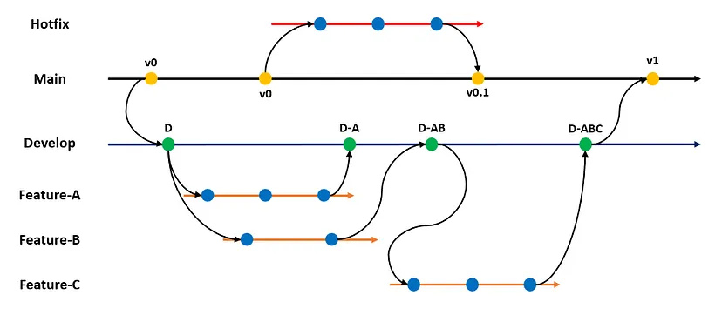
Git Branching: An Example (GitFlow)
Source: https://betterprogramming.pub/git-branching-strategy-for-better-team-collaboration-aacb5f235d05

Slide 13
A Simpler Git Workflow
The GitFlow is very comprehensive.
Can become unnecessarily complex for small projects.
It is more suited to Enterprise grade software development efforts.
For most use cases, it is overkill.
Therefore, a simpler alternative is preferable for most use cases.
One such workflow is the GitHub Flow which can be used by anybody.

Slide 14
The Github Flow
This is a GitHub based simple workflow.
Create a new feature branch from the main (master) branch.
Make the necessary changes to the feature branch – continue until you think your feature is ready.
Once you think the feature is done, ask for feedback from the other developers – create a Pull Request (PR) for this.
Address their review comments received on the Pull Request (PR).
Merge your Pull Request (PR) to the main branch.
Delete your feature branch.
Refer the official documentation here.

Slide 15
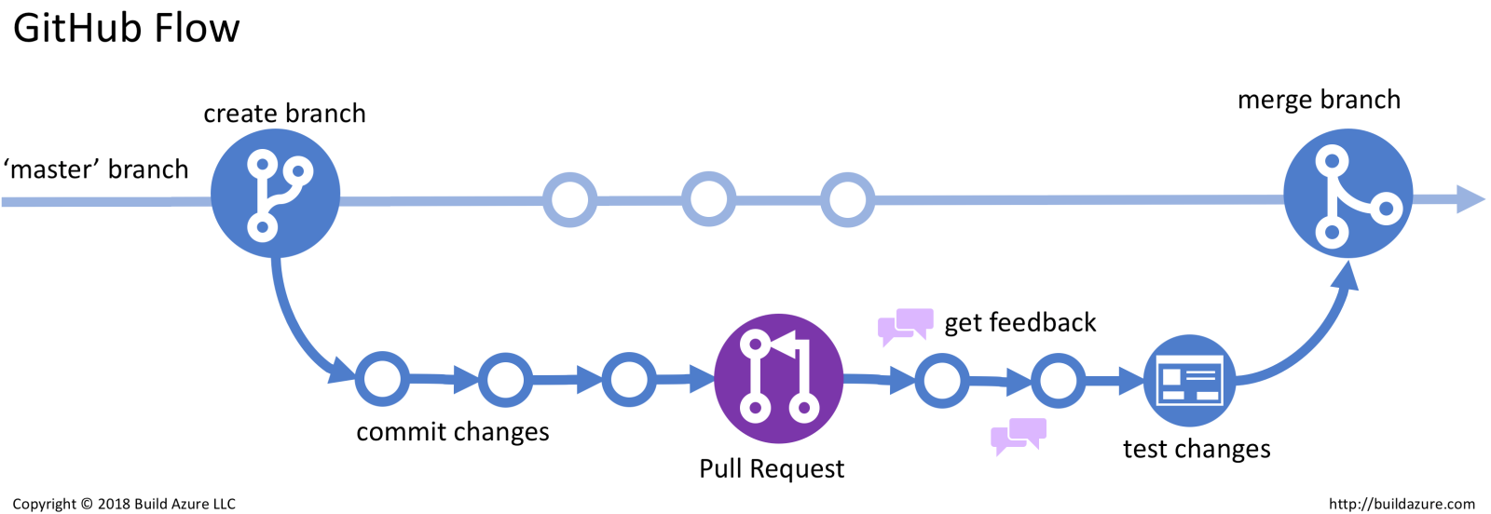
The Github Flow
Source: https://build5nines.com/introduction-to-git-version-control-workflow/

Slide 16
Pull Requests (PR)
A Pull Request (PR) is used to propose a new change to a repository (usually to the main branch).
Usually, the proposed changes are in a feature branch, which ensures that the main branch will only contain code which is tested and working.
The other collaborators will have to verify that the proposed change (PR) is OK first.
If the PR is OK, they will accept it. Or else, they will suggest changes until it is acceptable.
Once the PR is accepted, the changes in the feature branch are merged automatically to the main branch, bringing the proposed change to the main branch.
Find the official documentation on Creating PRs here.

Slide 17
Git Branching: Best practices
Create a branch for each feature. Do not work on multiple features in a single branch.
Ideally, only one person should work on one feature branch.
Feature branches should be short-lived. They should not exist once the feature is complete.
Delete the local and remote feature branch after merging to the master branch (see point 3).

Slide 18
Git Branching: Best practices
Merge early and often to avoid merge conflicts.
Keep the master branch clean. Only production ready code should be in the master branch. It is better to avoid working directly on the master branch.
Use a good naming convention to name your feature branches. Everyone should stick to the same naming convention.
E.g.:
feature/<username>/task-name-in-lowercase-spaces-replaced-with-dashes
feature/vishan.j/awesome-feature-x-to-our-app

Slide 19
Git general best practices
Make small, incremental changes.
Don’t make huge changes in one go. If you have a big feature to add, break it down to smaller features and add one at a time.
Keep commits atomic.
It is better if each commit is focused on one part of the feature. This will minimize the damage if you must revert a commit.
Commit often.
Commit your changes often. Even if the work is not done.
Pull the changes in origin/main branch before you create a new branch from your local/main.
This ensures that the new feature branch is created with all the latest changes in master. This reduces the possibility of merge conflicts later.

Slide 20
Git general best practices
Push local feature branch commits to Remote often.
Even if it is an unfinished feature, push it. That’s good for safekeeping.
Use branches.
See the section on branching for a comprehensive set of reasons.
Write good commit messages.
Make the lives of other Software Engineers, DevOps engineers, QA engineers easier.
Select one branching strategy (Git Workflow) and stick with it.
Select one that suits you and use it well.

Slide 21
Summary
Git branching
The basics
How do we create a branch on git?
Workflows (Branching strategies)
An Example (GitFlow)
A Simpler Git Workflow
The GitHub Flow
Pull Requests (PRs)
Best practices for branching
Git general best practices

Slide 22
Additional Topics
Read on these topics to be up to date on some current trends.
Continuous Integration and Continuous Deployment (CI/ CD).
Compare Trunk based development workflow with GitFlow workflow.
Understand when to use which.
Read on Pull Requests.
Read on Git Rebase and see why it’s a better alternative to Git Merge.

Slide 23
References
Pro Git - Scott Chacon and Ben Straub [Free eBook]
Dangit, Git!?! [Git quick reference]
Branch in Git
What Are the Best Git Branching Strategies
10 Git Branching Strategy Best Practices
Trunk-based Development vs. Git Flow
How to Use Git and Git Workflows – a Practical Guide

Slide 24

Thank You
Vishan.j@sliit.lk
nelum.a@sliit.lk

